Slide 1
Visualization of DRL learning process using t-SNE
Mid-term Presentation
Manor Zvi and Guy Shkury
Tom Zahavy
24.01.2019

Slide 2
Agenda
Introducing the problem
Background
Related work
Challenges
Proposed Solution

Slide 3
The problem
Goal: Visualizing learning process of DRL
Existing solution: t-SNE maps of last level activation layers, over time
Challenge: t-SNE maps are inconsistent due to randomness
Motivation: existing solution fails to visualize progress

Slide 4
Background

Slide 5
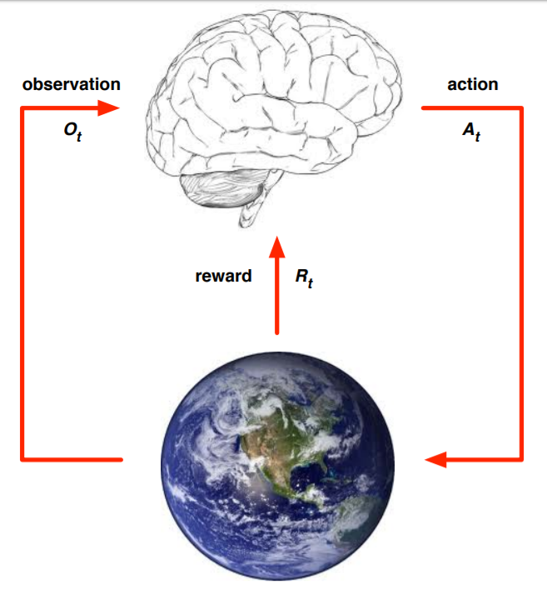
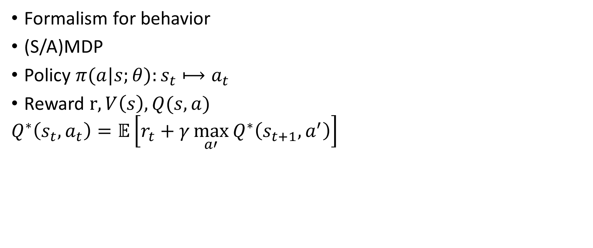
Reinforcement Learning
Formalism for behavior
(S/A)MDP
Policy $π(a|s;θ):s_{t}⟼a_{t}$
Reward $r,V\left(s\right), Q(s,a)$
$$Q^{∗}\left(s_{t},a_{t}\right)=𝔼\left[r_{t}+γ\max_{a′}{Q^{∗}\left(s_{t+1},a^{′}\right)}\right]$$
Based on David Silver’s slides, UCL Course on RL

Slide 6
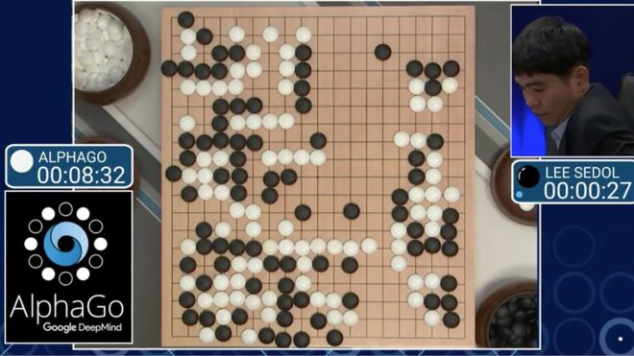
Deep Reinforcement Learning
DL application for RL
Handles unstructured environments
Great performance in classic games
DQN

Slide 7
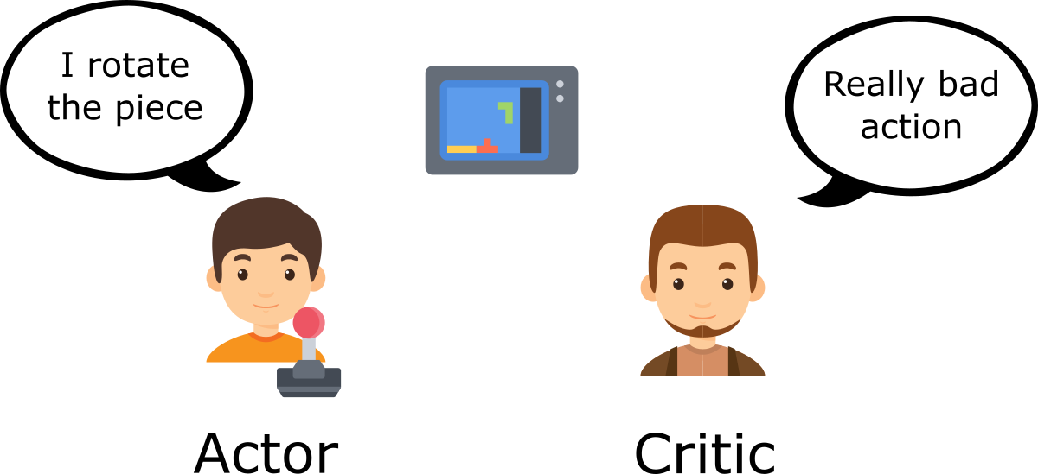
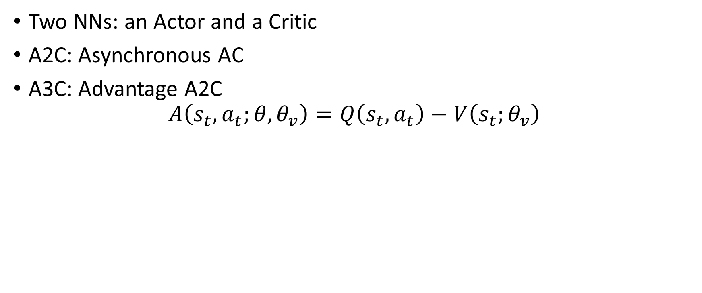
Actor Critic
Two NNs: an Actor and a Critic
A2C: Asynchronous AC
A3C: Advantage A2C
$$A\left(s_{t},a_{t};θ, θ_{v}\right)=Q\left(s_{t},a_{t}\right)−V\left(s_{t};θ_{v}\right)$$
From Thomas Simonini’s: An intro to Advantage Actor Critic methods

Slide 8
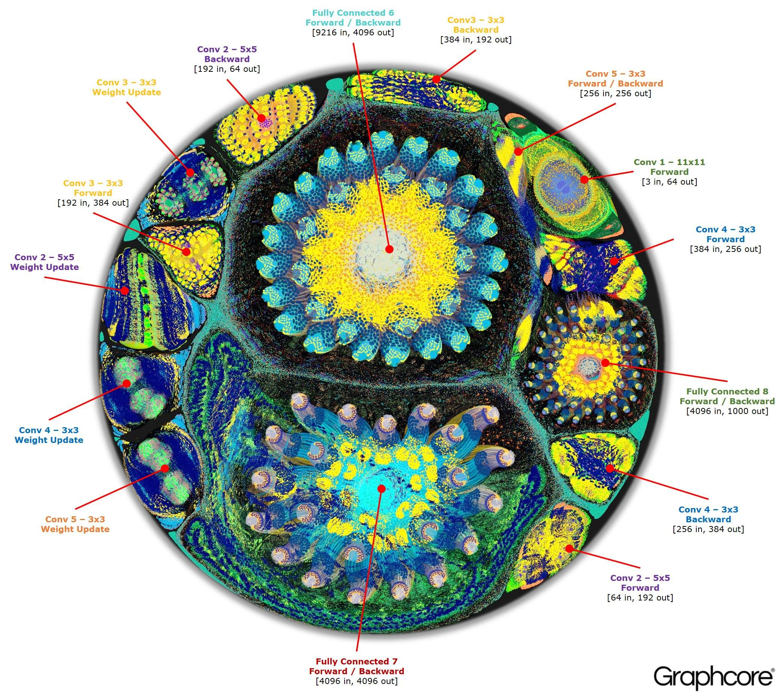
Visualization of NNs
Dimensionality Reduction
Clustering
Inference of relevant information
Graphcore’s visualization of Alexnet

Slide 9
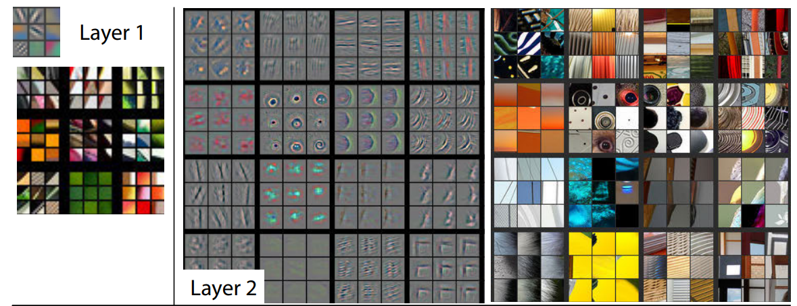
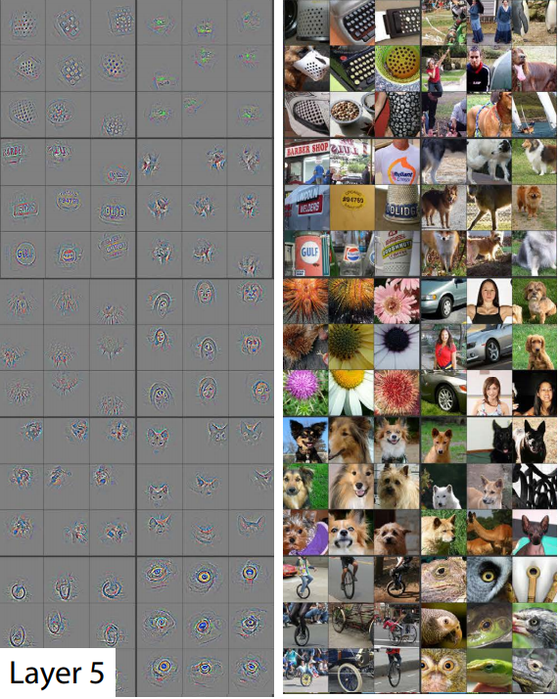
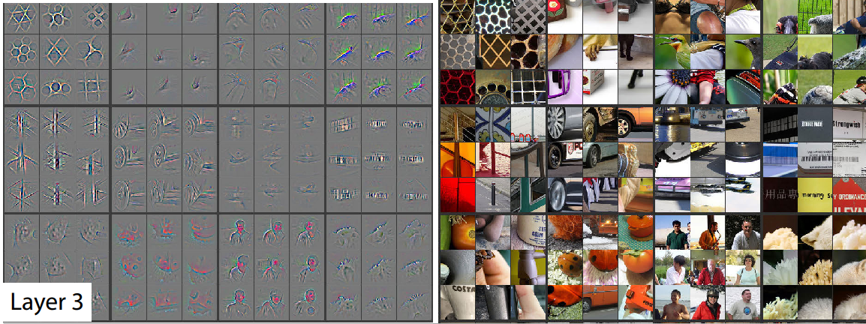
Zeiler and Fergus, 2014

Slide 10
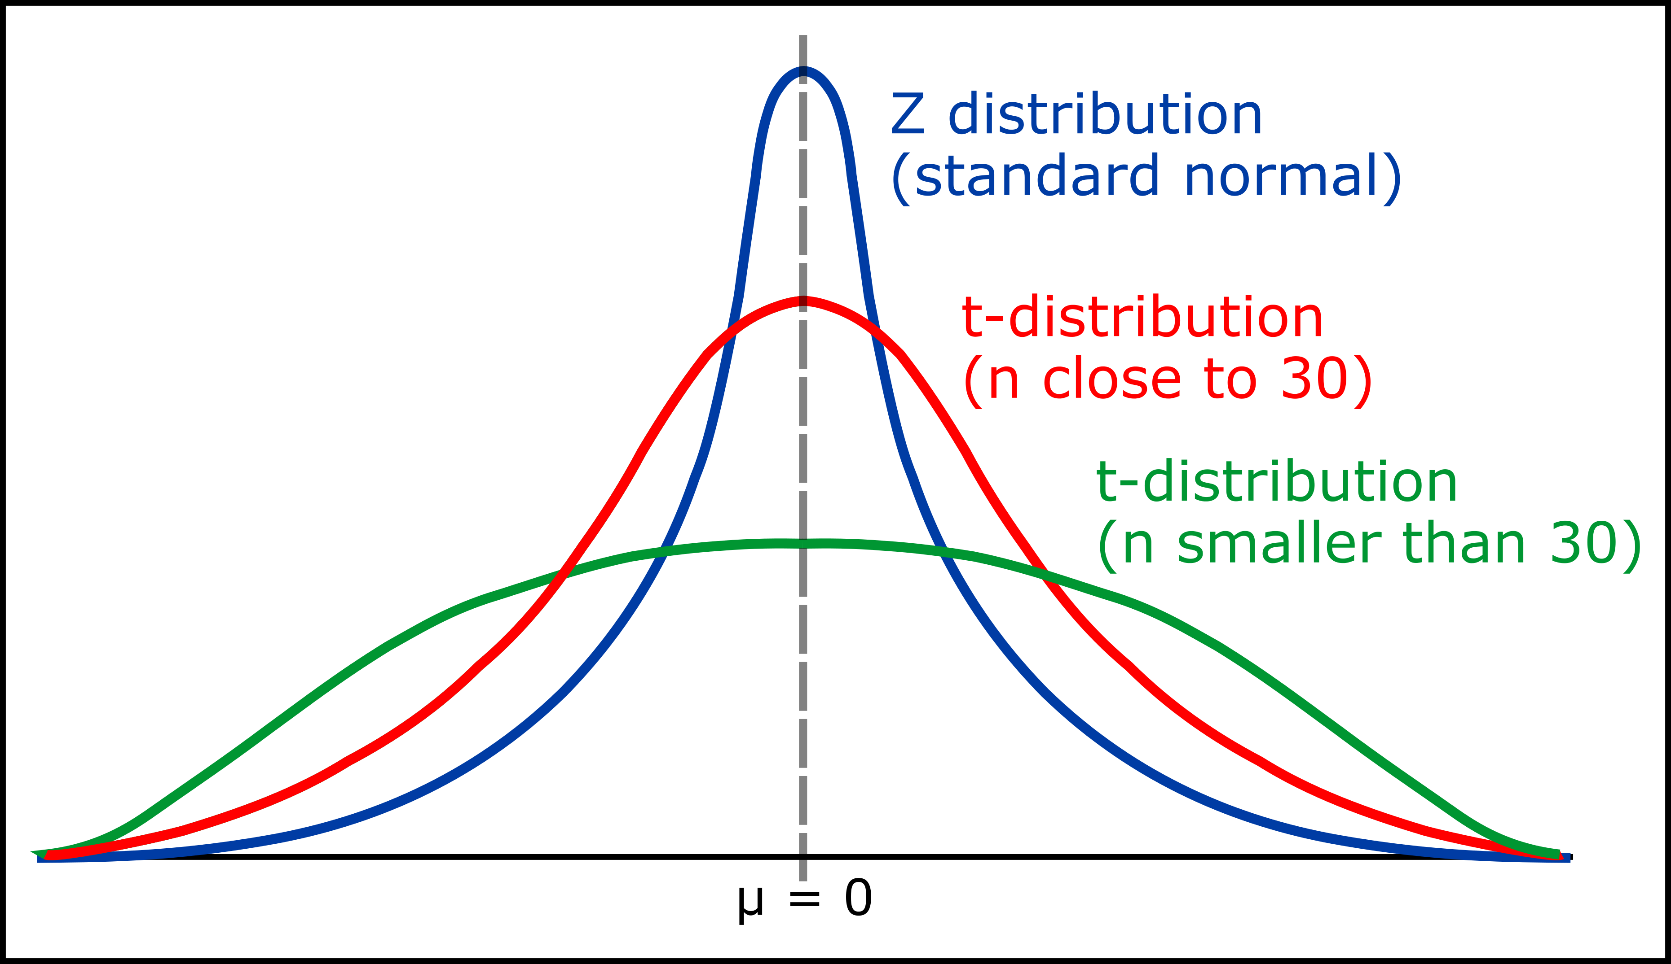
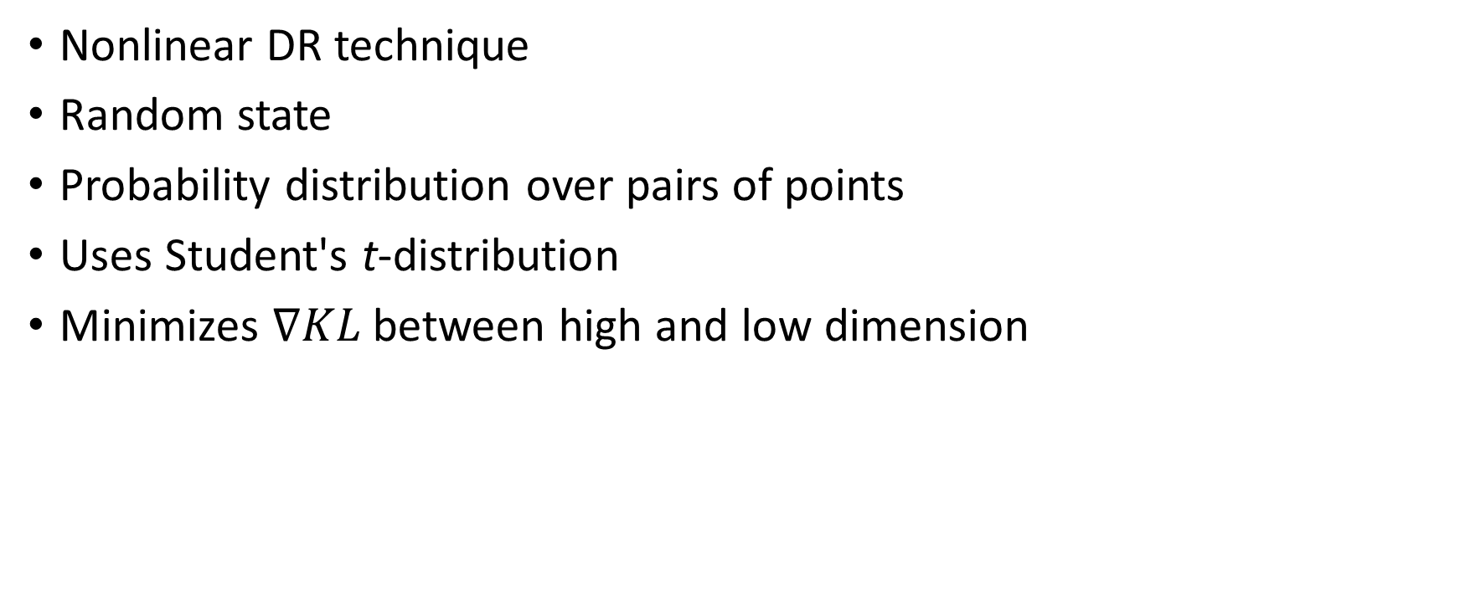
t-SNE
Nonlinear DR technique
Random state
Probability distribution over pairs of points
Uses Student's t-distribution
Minimizes $∇KL$ between high and low dimension

Slide 11
Related Work

Slide 12
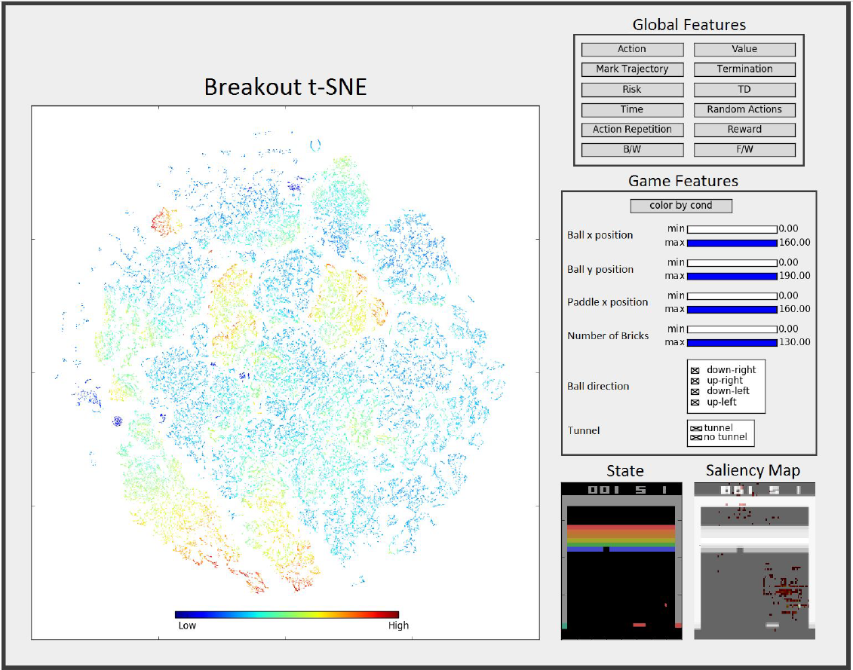
Graying the Black Box
SAMDP
Actions and skills
Visualization tool

Slide 13
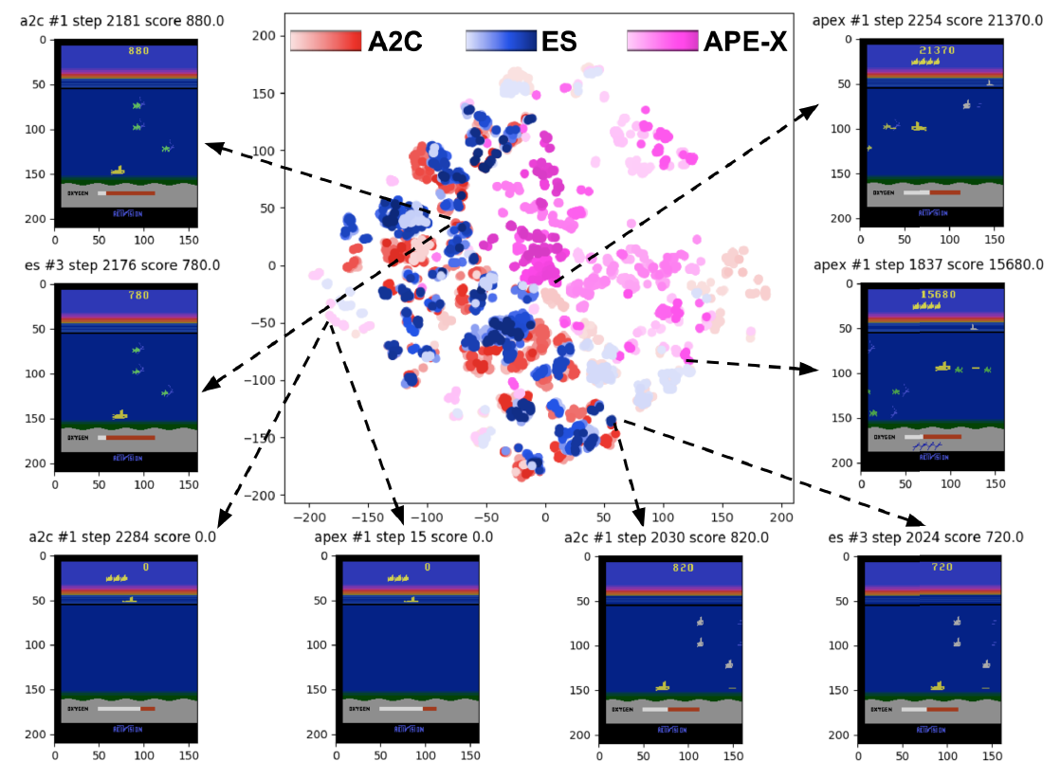
Atari Model Zoo
Release of trained DRL models
Contains training data
Enables easy analysis
Visualization tool

Slide 14
Challenges

Slide 15
t-SNE Consistency
Small changes in the data may cause large changes in the t-SNE map
Hard to follow progress
T-SNE over data
t-SNE over data with noise
(“jumping clusters”)

Slide 16
Activation layers t-SNE map
Activation layers t-SNE map after 1 batch train
Activation layers t-SNE map after 10 batches train
Activation layers t-SNE map after 1 epoch train

Slide 17
Proposed Solution

Slide 18
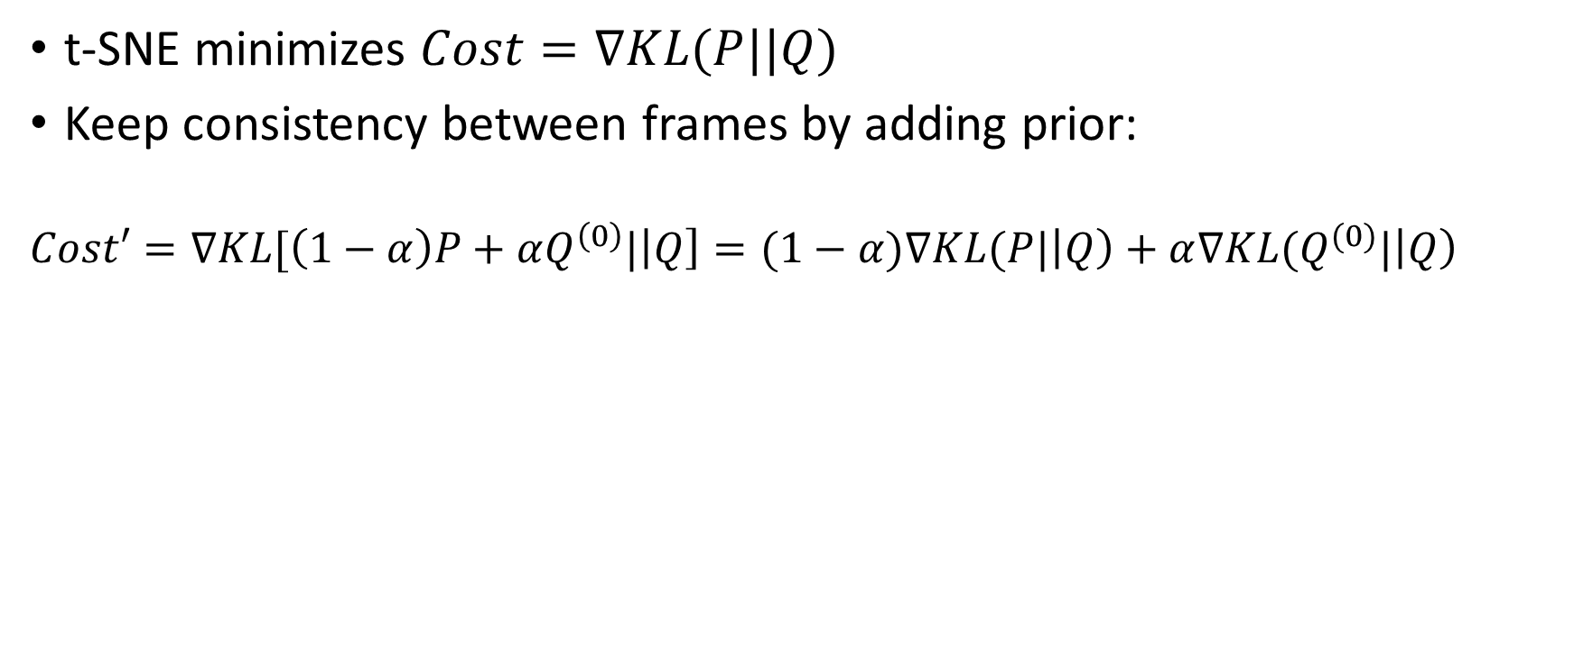
Adding prior for frame consistency
t-SNE minimizes $Cost=∇KL(P||Q)$
Keep consistency between frames by adding prior:
$$Cost′=∇KL[\left(1−α\right)P+αQ^{\left(0\right)}|\left|Q\right]=(1−α)∇KL(P|\left|Q\right)+α∇KL(Q^{(0)}|\left|Q\right)$$
T-SNE over data
t-SNE over data with noise using this prior

Slide 19
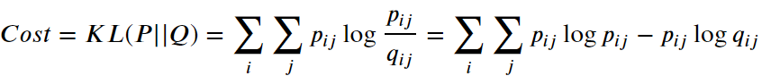
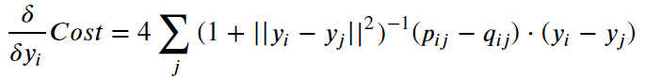
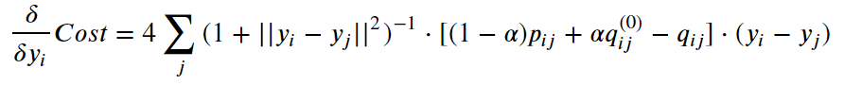
Detailed Gradient
d
Original gradient:
Proposed gradient:

Slide 20
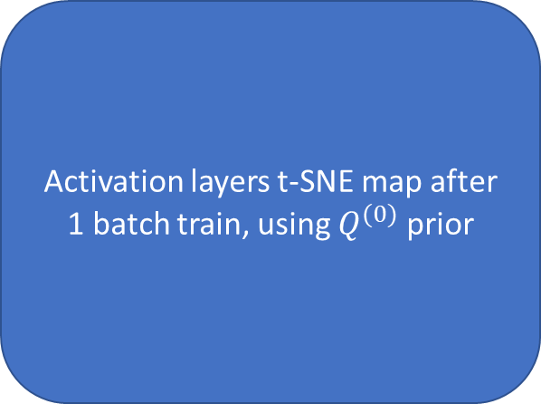
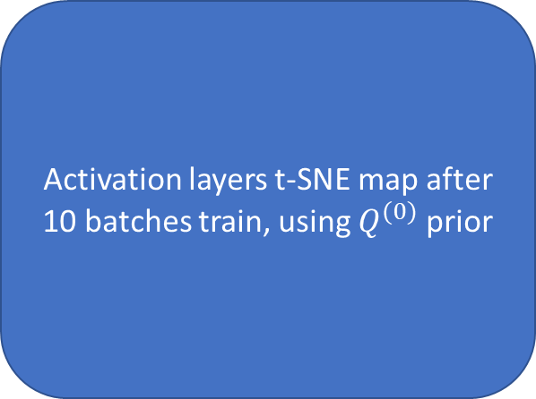
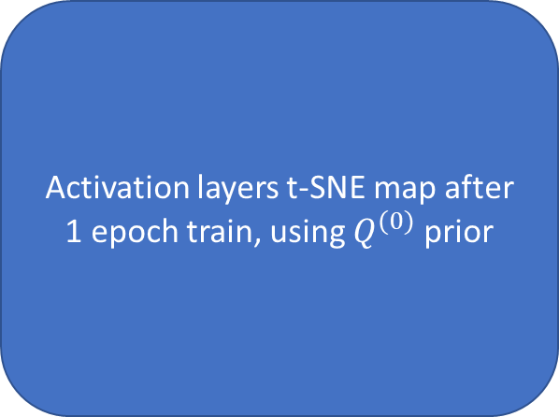
Activation layers t-SNE map
Activation layers t-SNE map after 1 batch train, using $Q^{(0)}$ prior
Activation layers t-SNE map after 10 batches train, using $Q^{(0)}$ prior
Activation layers t-SNE map after 1 epoch train, using $Q^{(0)}$ prior

Slide 21
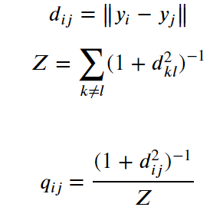
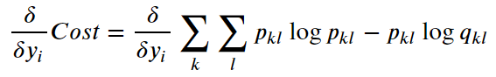
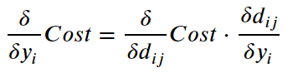
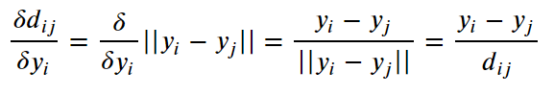
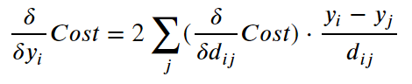
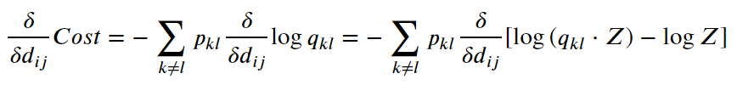
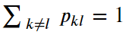
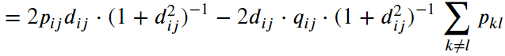
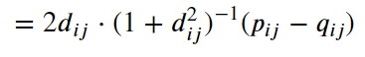
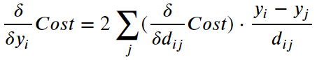
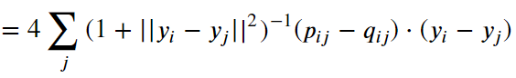
Original gradient calculation (Hidden)
;

Slide 22
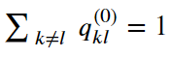
Modified gradient calculation (Hidden)
;

Slide 23
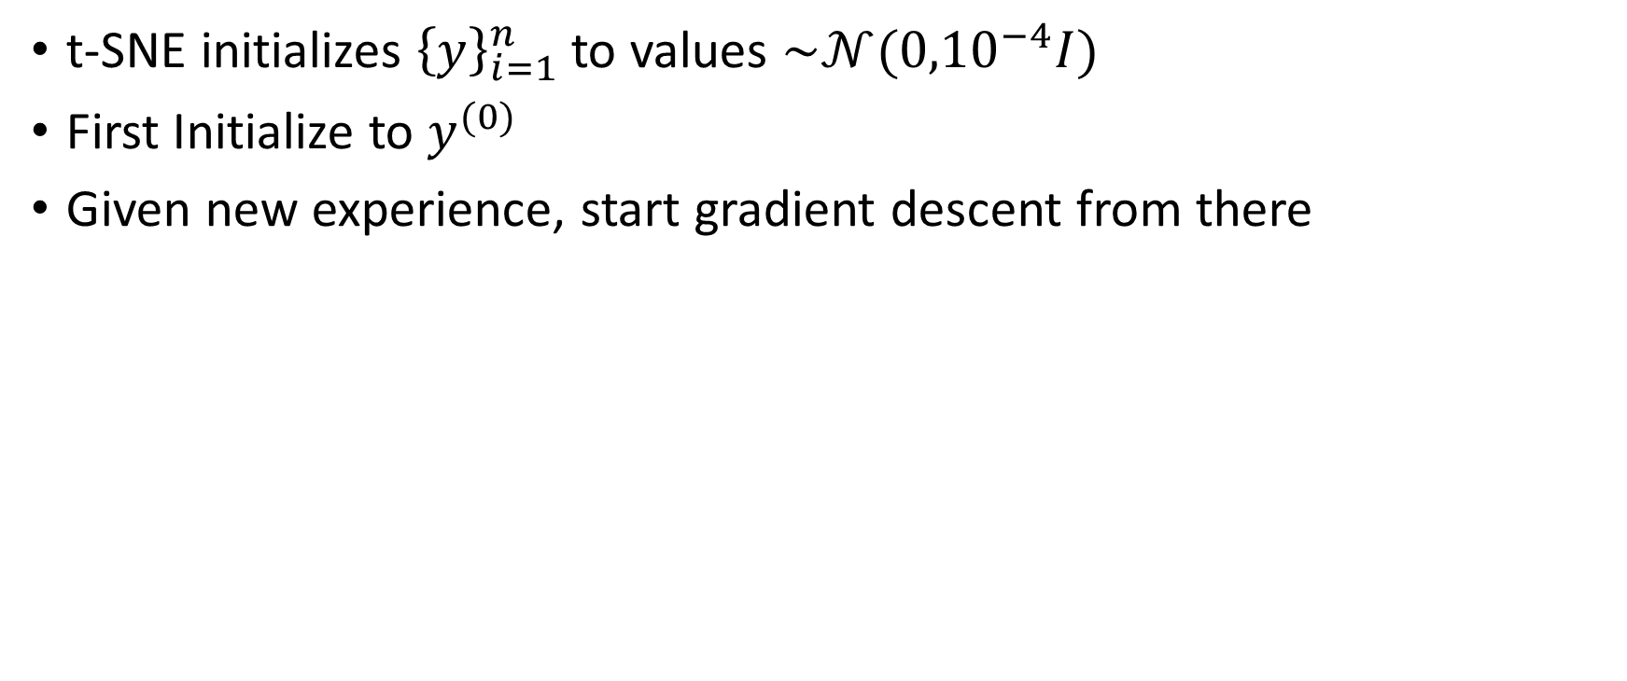
Prior for t-SNE initialization
t-SNE initializes ${\left\{y\right\}}_{i=1}^{n}$ to values $\sim 𝒩({0,10}^{−4}I)$
First Initialize to $y^{(0)}$
Given new experience, start gradient descent from there
T-SNE over data
t-SNE over data with noise using this prior

Slide 24
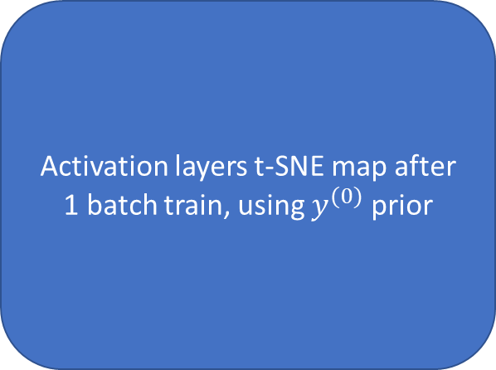
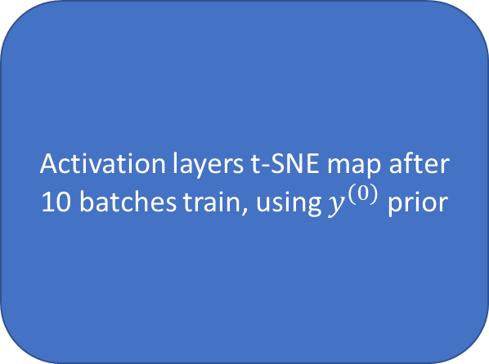
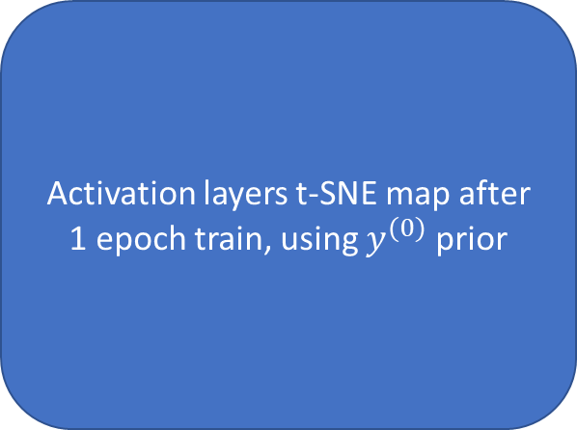
Activation layers t-SNE map
Activation layers t-SNE map after 1 batch train, using $y^{(0)}$ prior
Activation layers t-SNE map after 10 batches train, using $y^{(0)}$ prior
Activation layers t-SNE map after 1 epoch train, using $y^{(0)}$ prior

Slide 25


